Slide 1
Kenya Health Enterprise Architecture (KHEA) and DATA SERVICES LAYER (DSL)
Demo
Visit: http://dss.azurewebsites.net/mohdsl.aspx

Slide 2
Background
Weak HIS as identified by Kenya Health System Policy.
A challenge in decision making
HIS use multiple uncoordinated data collection systems.
The need to come up with a blueprint
The blueprint:
Kenya Health Enterprise Architecture

Slide 3
KHEA - Goals
Business Goals:
Guide health sector decision making,
Showing the implications of progress (or lack of it) being made by the sector;
Guide implementation of services
By providing information on the outputs of actions being carried out;
Guide the information dissemination and use by health sector stakeholders and with public;
Provide a collaborative approach to monitoring progress by different planning elements

Slide 4
KHEA - Goals
Architecture Goals:
Provides a common language for agencies involved in the delivery of cross-agency services
Enhances collaboration by identifying duplicate, re-usable and sharable services
Assists in describing and analyzing IT investments
Assists in making government citizen-centric, results-oriented and market-based

Slide 5
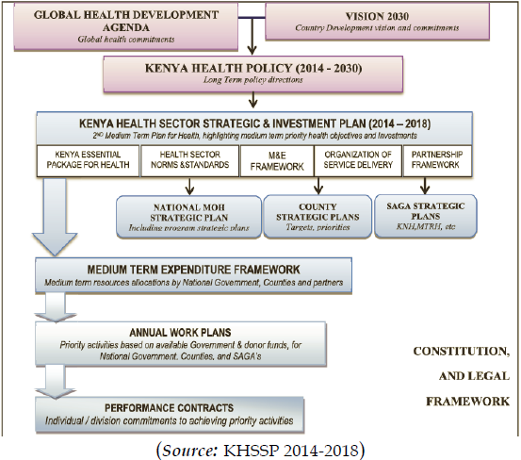
Strategy Reference Model

Slide 6
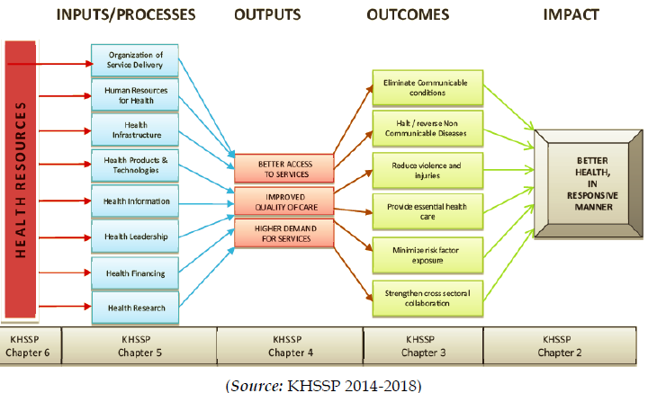
Business Reference Model

Slide 7
What is DSL?
Data Services Layer:
An integration and aggregation of health and related data sources that could potentially impact on health.
Platform for collaboration and sharing of health information
Analyze, predict, anticipate diverging and converging health factors
Support M&E functions for decision making
Discovery of complex interlinkages in health determinants

Slide 8
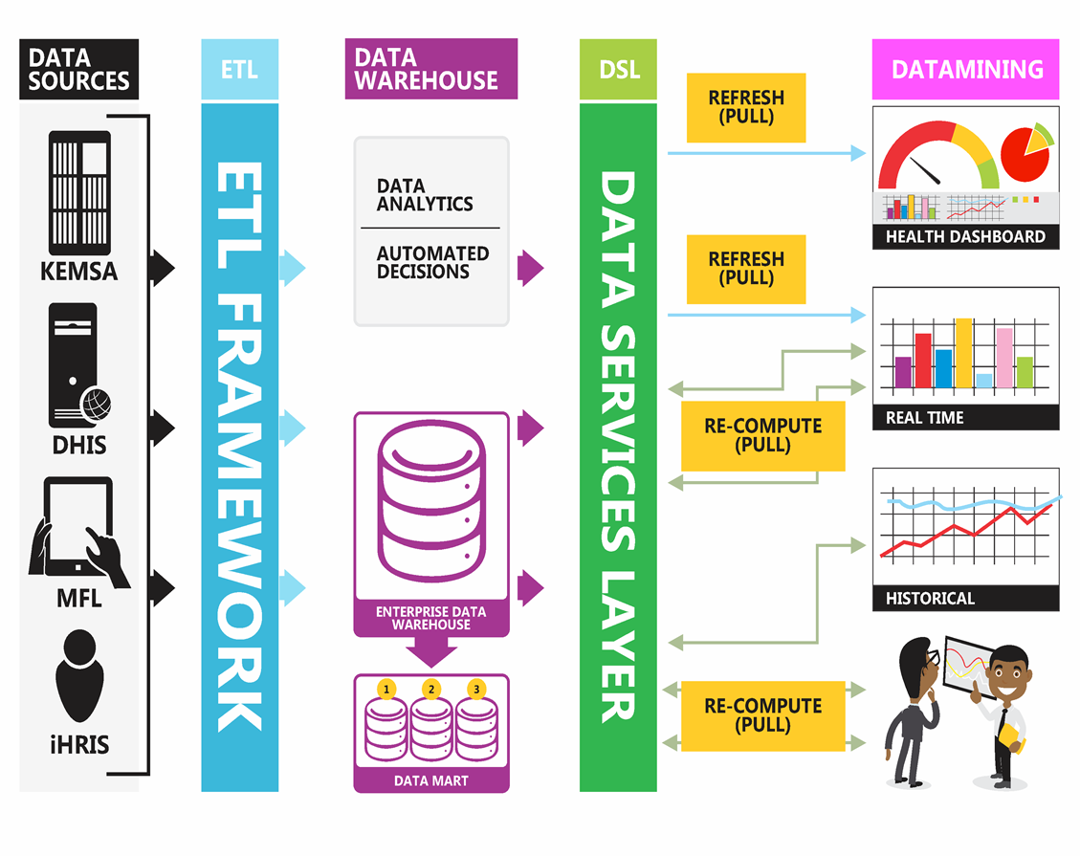
DSL Implementation

Slide 9
Value of DSL
Using the DSL for analytics
Gain better insights can help demonstrate value and achieve better outcomes. E.g. KEMSA to accurately predict the demand of drugs by each county or region or facility
Capability to “see the future” – Predictive analytics
With more data sources in DSL
MoH will be able to conduct clinical trials and experiments from data
Predictive Analytics
Create more personalised healthcare,
Predict patient behaviour

